Slide 2
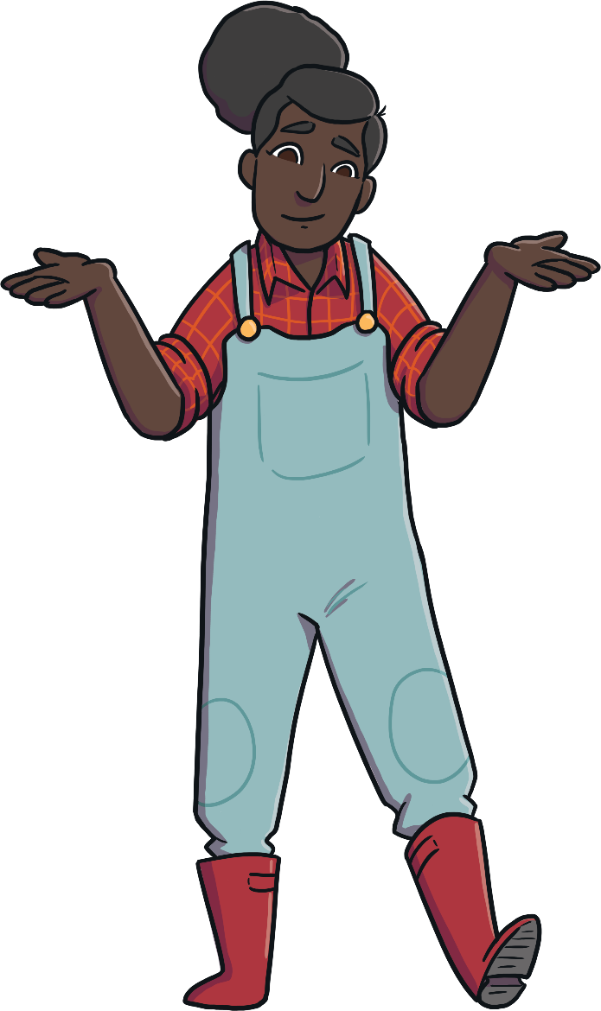
What Am I? Kdo sem jaz?
Can you follow the clues to work out which farm animal is being described?
Sledi namigom in ugotovi, katera žival je opisana.
Click on the suns to reveal each clue!
S klikom na sonce se ti bo prikazal naslednji namig!
Start

Slide 3
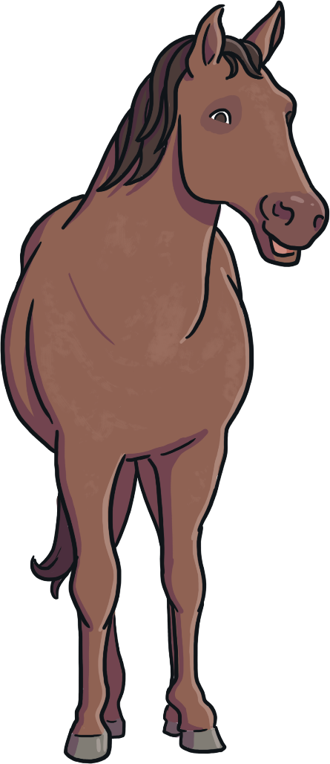
What Am I?
I am a horse!
I am very tall. Sem visok.
I have a long mane. Imam dolgo grivo.
I eat hay. Jem seno.
What am I?
Click on me to reveal the answer!
Previous
Next

Slide 4
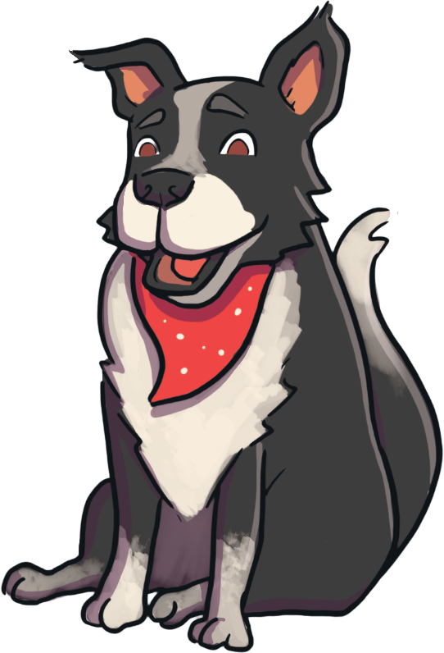
What Am I?
I have four legs. Imam 4 noge.
I am a dog!
I like to go for walks. Rad se sprehajam.
I bark. Lajam.
What am I?
Click on me to reveal the answer!
Previous
Next

Slide 5
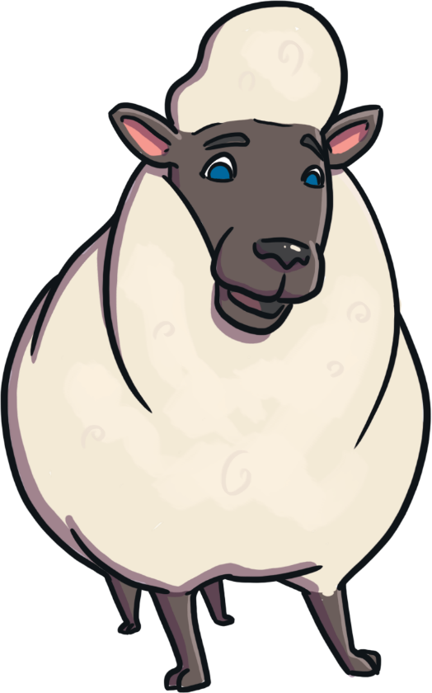
What Am I?
I eat grass. Jem travo.
I am a sheep!
My babies are called lambs. Moji dojenčki se imenujejo jagenjčki.
I have wool on my body. Na telesu imam volno.
What am I?
Click on me to reveal the answer!
Previous
Next

Slide 6
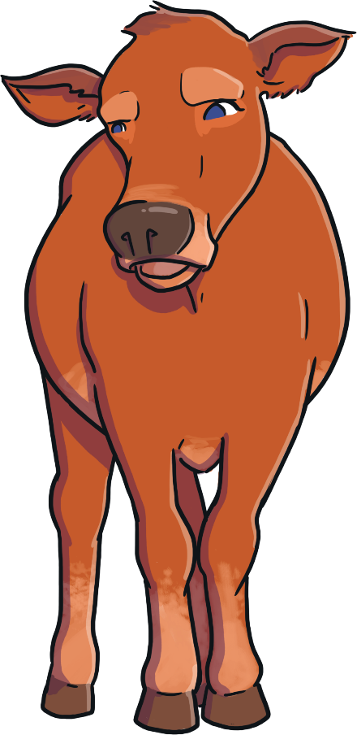
What Am I?
I am quite big. Sem velika.
I am a cow!
I make milk. Proizvajam mleko.
I say ‘moo’. Oglašam se z „muu“.
What am I?
Click on me to reveal the answer!
Previous
Next

Slide 7
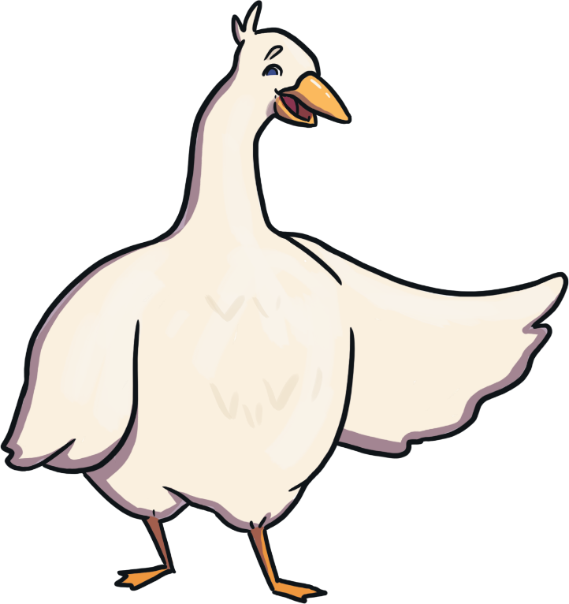
What Am I?
I have two legs. Imam dve nogi.
I am a goose!
I have a beak. Imam kljun.
I like to swim. Rada plavam.
What am I?
Click on me to reveal the answer!
Previous
Next

Slide 8
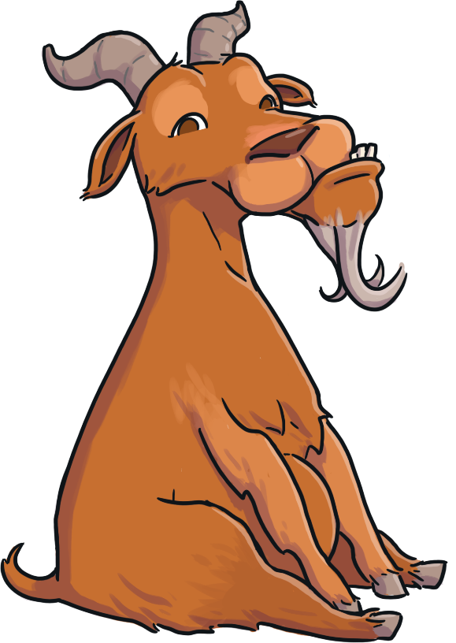
What Am I?
I sometimes have horns. Včasih imam rogove.
I am a goat!
I am a bit like a sheep. Nekoliko sem podobna ovci.
I like to climb. Rada plezam.
What am I?
Click on me to reveal the answer!
Previous
Next

Slide 9
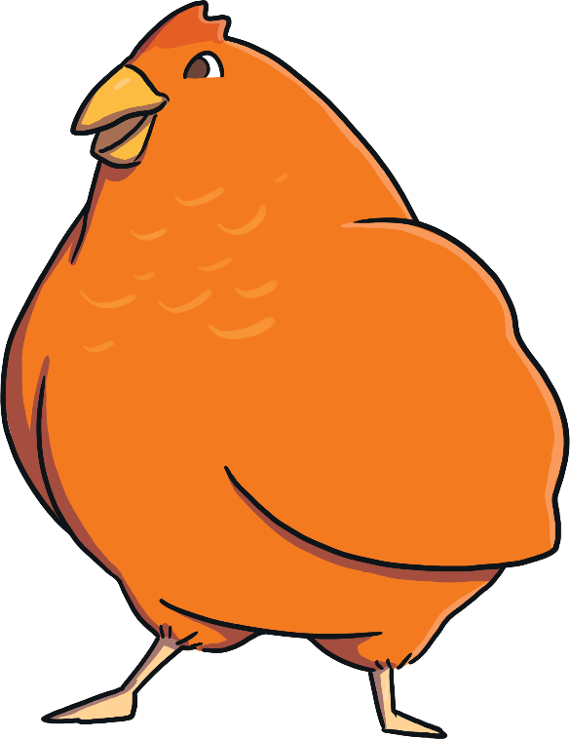
What Am I?
I cluck. Kokodakam.
I am a chicken!
I have feathers. Imam perje.
I lay eggs. Valim jajca.
What am I?
Click on me to reveal the answer!
Previous
Next

Slide 10
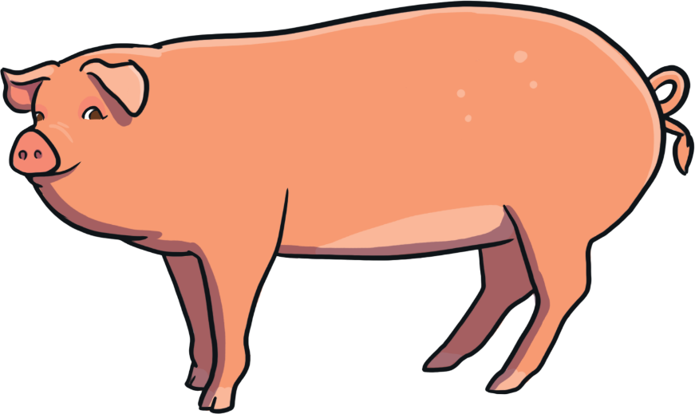
What Am I?
I have a curly tail. Imam zvit repek.
I am a pig!
I like to roll in mud. Rad se valjam v blatu.
I have a snout. Imam smrček.
What am I?
Click on me to reveal the answer!
Previous
Next

