Slide 1
GUESS WHO?

Slide 2
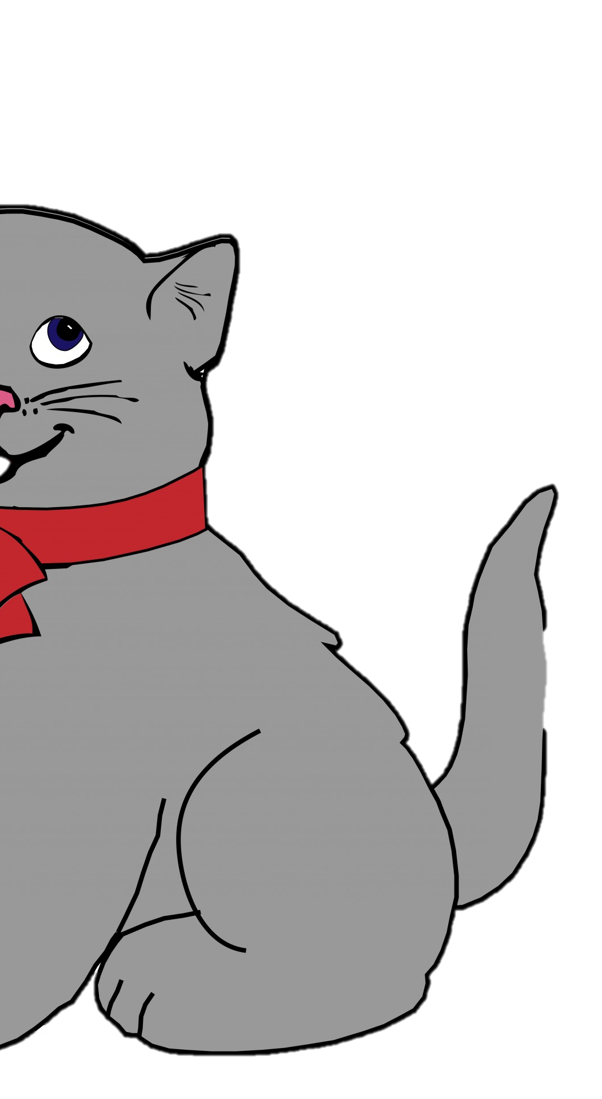

Slide 3
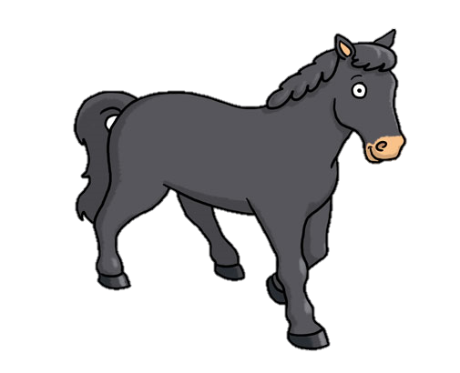
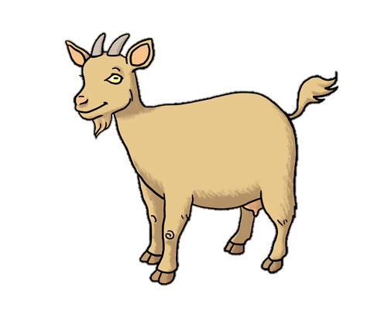

Slide 5
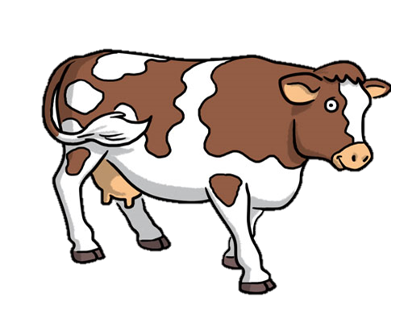

Slide 6
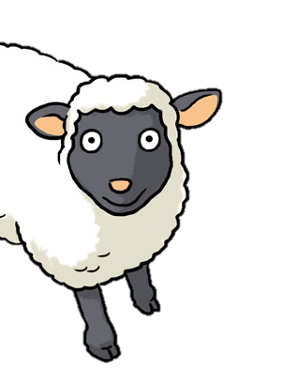

Slide 7
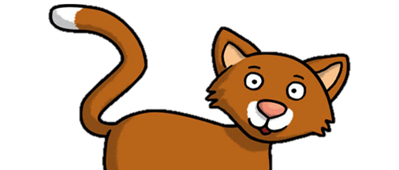

Slide 8
POBARVAJ POBARVANKO https://www.online-coloring.com/coloring-page/rural-landscape-and-farm-animals-202.html

